Slide 1
Learning Python
20220928

Slide 2
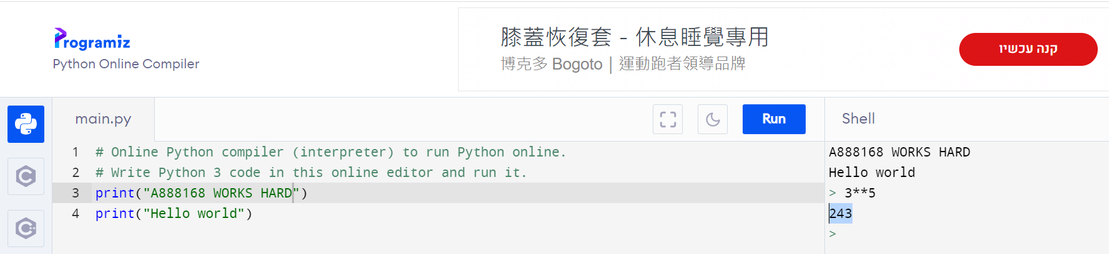
Python Online Interpreter:1
INTERACTIVE

Slide 3
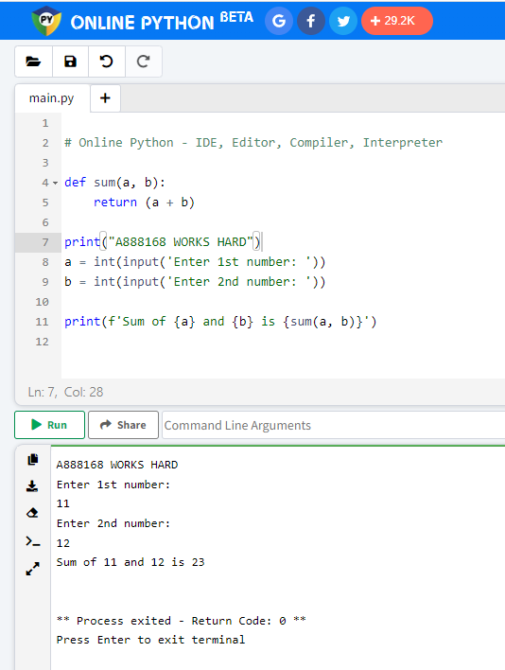
Python Online Interpreter:2

Slide 4
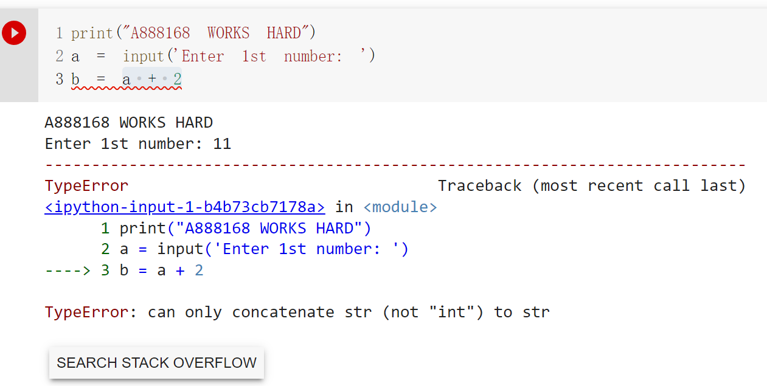
Data type

Slide 5
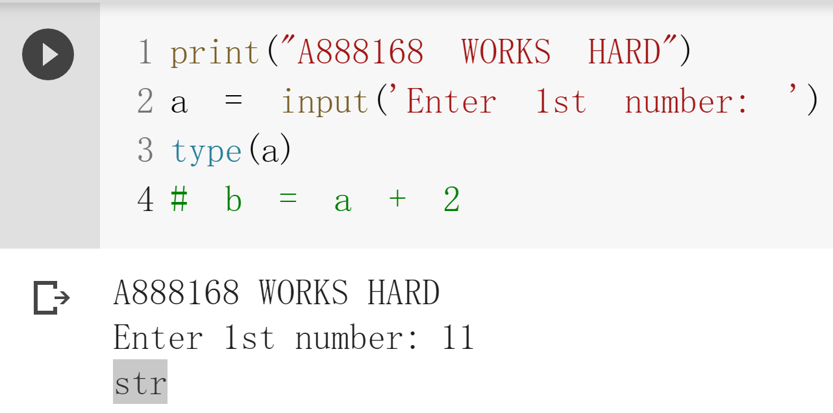

Slide 6
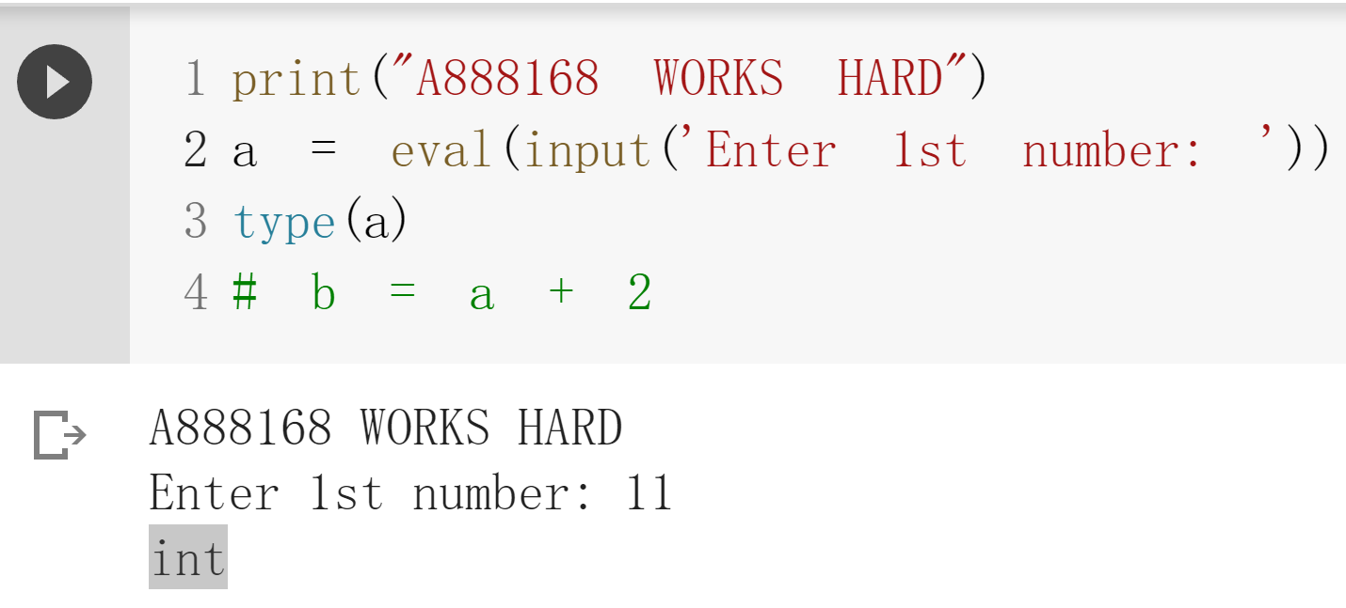

Slide 7
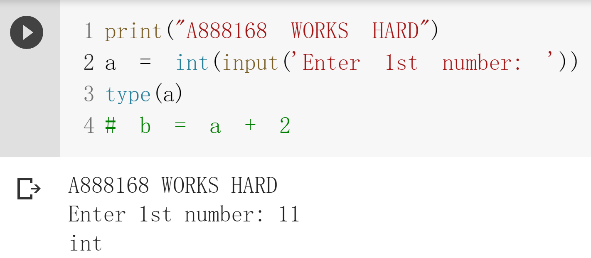

Slide 8
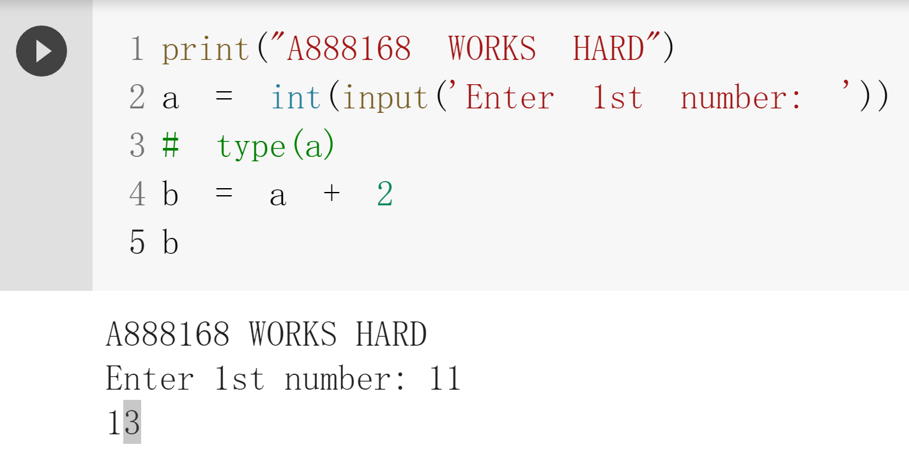

Slide 9
Data type

